Slide 1
$q$-MAX: A Unified Scheme for Improving Network Measurement Throughput
Ran Ben Basat, Harvard University
Joint work with
Gil Einziger (Ben Gurion University), Junzhi Gong (Harvard University), Jalil Moraney (Technion), Danny Raz (Technion)

Slide 2
Network Measurement
Network Measurement
Network Monitoring
Analyze the underlying traffic.
Provide statistics about
heavy flows/networks
,
number of distinct flows
, distribution entropy, etc.
Used for variety of applications including traffic engineering, intrusion detection, and attack localization.

Slide 3
The $q$-$MAX$ Problem
Track the largest $q$ integers in a stream.
Standard implementations include:
Heap
Skip List
Balanced Search Tree
7
2
2
7
3
5
1
0
7
2
2
7
3
4
1
0
7
8
2
7
3
5
1
0
7
2
2
7
3
4
1
0
7
3
9
1
0
7
2
2
7
3
5
1
0
7
2
2
7
3
4
1
0
7
2
2
7
3
4
1
9
7
3
4
1
0
7
2
2
7
3
5
1
0
7
2
2
7
3
4
1
0
Update time = $O(\log{q})$.

Slide 4
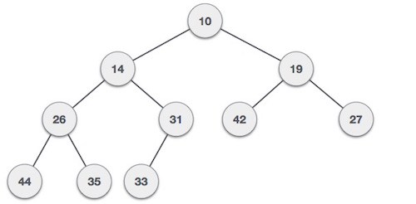
Count Sketch (TCS, 2004)
0 | 0 | 0 | 0 | 0 | 0 | 0 | 0 | 0 | 0 | 0 | 0 | 0
0 | 0 | 0 | 0 | 0 | 0 | 0 | 0 | 0 | 0 | 0 | 0 | 0
0 | 0 | 0 | 0 | 0 | 0 | 0 | 0 | 0 | 0 | 0 | 0 | 0
0 | 0 | 0 | 0 | 0 | 0 | 0 | 0 | 0 | 0 | 0 | 0 | 0
0 | 0 | 0 | 0 | 0 | 0 | 0 | 0 | 0 | 0 | 0 | 0 | 0
0 | 0 | 0 | 0 | 0 | 0 | 0 | 0 | 0 | 0 | 0 | -1 | 0
0 | 0 | 0 | 0 | 1 | 0 | 0 | 0 | 0 | 0 | 0 | 0 | 0
0 | 0 | 0 | 0 | 0 | 0 | 0 | 0 | 0 | 0 | 0 | -1 | 0
0 | 0 | 0 | 0 | 0 | 0 | 0 | 0 | 0 | 0 | -1 | 0 | 0
0 | 1 | 0 | 0 | 0 | 0 | 0 | 0 | 0 | 0 | 0 | 0 | 0
0 | 0 | 0 | 0 | 0 | 0 | 0 | 0 | 0 | 0 | 0 | -2 | 1
0 | 0 | 0 | 0 | 3 | 0 | 0 | 0 | 0 | 0 | 0 | 0 | 0
0 | 0 | 0 | 0 | 0 | 0 | 0 | 0 | 0 | 0 | 0 | -3 | 0
0 | 0 | 0 | 0 | -1 | 0 | 0 | 0 | 0 | 0 | -2 | 0 | 0
0 | 1 | 0 | 0 | 0 | 0 | 0 | 0 | 0 | 0 | 0 | 0 | 0
0 | 0 | 0 | 0 | 0 | 0 | 0 | 0 | 0 | 0 | 0 | -1 | 1
0 | 0 | 0 | 0 | 2 | 0 | 0 | 0 | 0 | 0 | 0 | 0 | 0
0 | 0 | 0 | 0 | 0 | 0 | 0 | 0 | 0 | 0 | 0 | -2 | 0
0 | 0 | 0 | 0 | -1 | 0 | 0 | 0 | 0 | 0 | -1 | 0 | 0
0 | 0 | 0 | 0 | 0 | 0 | 0 | 0 | 0 | 0 | 0 | 0 | 0
Query( )
= median(2,3,3,2,1)

Slide 5
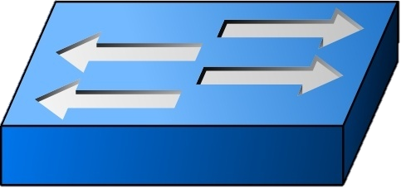
Routing Oblivious Heavy Hitters (ANCS 2018)
Which flows sent more than 1% of the packets?
How many packets has sent?
Routing Oblivious:
Assumes no routing knowledge
Routing may arbitrarily change over time
Distributed Implementation

Slide 6
Routing Oblivious Heavy Hitters (ANCS 2018)
Every switch hashes each packet into $[0,1]$ and stores the keys of the $q$ with the largest hash.
The controller gets $q$ samples from each switch and computes the globally largest hashes.

Slide 7
Routing Oblivious Heavy Hitters (ANCS 2018)
517
321
518
518
322

Slide 8
Applications
Priority Based Aggregation (CIKM’17)
UnivMon (SIGCOMM’16)
NitroSketch (SIGCOMM’19)
Dynamic Bucket Merge (NSDI’11)
…

Slide 9
Is that a real bottleneck?
Sketches maintain extra data structures for tracking “heavy” flows that incur expensive per packet operations
(NitroSketch, SIGCOMM 2019)
$$q={10}^{4}$$
$$q={10}^{7}$$
Algorithm | Current Overhead
Priority Sampling | 50-58%
Network Wide Heavy Hitters | 22-28%
Priority-based Aggregation | 18-19%
UnivMon | ~15%
Current Overhead
93-96%
83-88%
20-21%

Slide 10
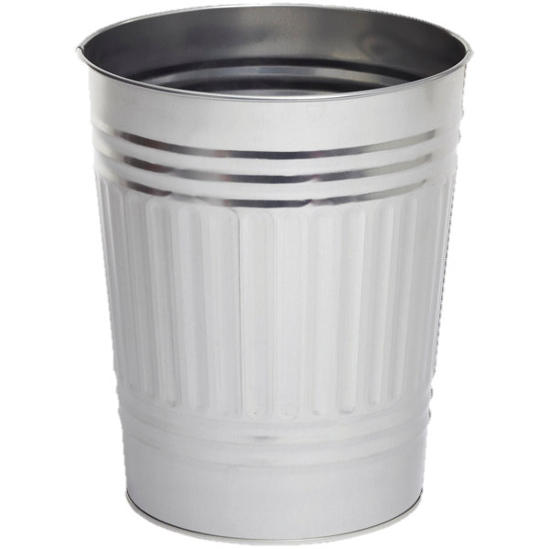
Our solution
In this example, $q=4,γ=3/2$
4
7
4
9
$$q(1+γ/2)$$
$$q⋅γ/2$$
4
7
5
5
3
8
7
7
7
4
5
5
8
3
7
7
4
4
9
0
0
0
0
0
0
0
0
0
9
0
Small
Large
New
Over $q⋅γ/2$ items
Computing quantiles takes $O(q)$ time
$$≥$$
The $q$^{th} largest item is 5
Pivoting takes $O(q)$ time
$⇒$Worst case update time = $O(γ^{−1})$

Slide 11
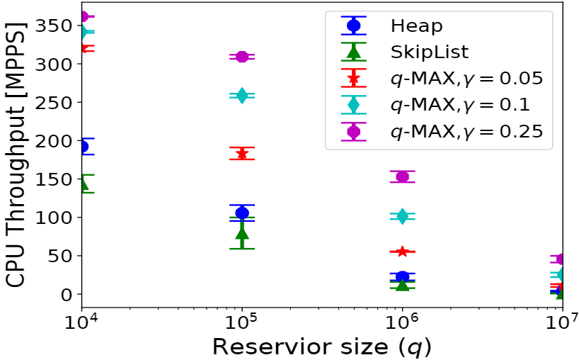
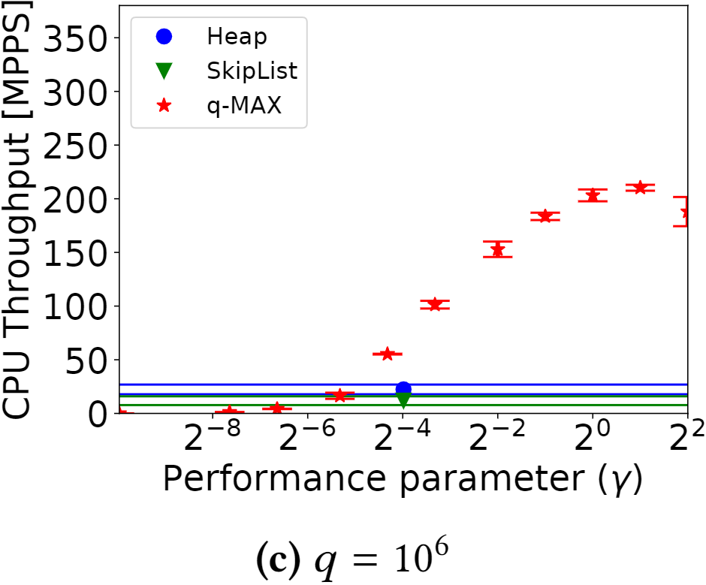
Is it faster?
Sometimes
CPU Cache
DRAM
$$q\left(1+γ\right)$$
$$q$$

Slide 12
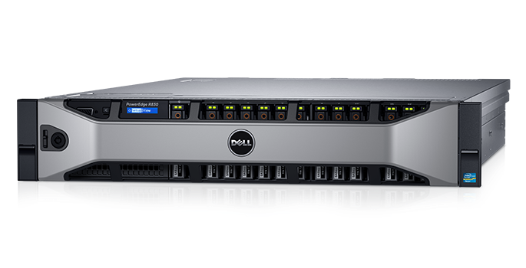
Open vSwitch Implementation
Server A: Traffic Generator
We send min-sized packets with headers from Internet traces on 10G link.
We send real-sized packets on 40G link.
Server B: DPDK enabled Open vSwitch
Performs measurement in data plane using a single thread.
Server A: Traffic generator
Serve B: Open vSwitch
Traffic Generator
Open vSwitch

Slide 13
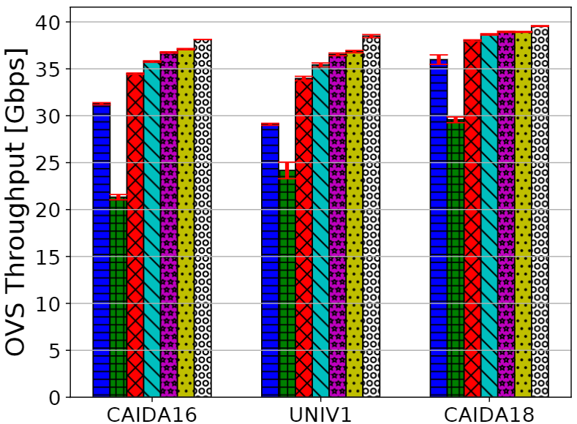
OVS throughput - $q=10^{6}$
Network Wide Heavy Hitters

Slide 14
Additional Contributions
Lower bounds
Any $q$-MAX algorithm with $q+O\left(1\right)$ space requires $Ω(\log{\log{q}})$ update time.
Any $q$-MAX algorithm with $O\left(1\right)$ update time needs $q+Ω(\log{\log{q}})$ space.
Sliding Windows
Any $1$-MAX algorithm needs $Ω(W)$ space [SICOMP’02].
Relaxation to approximate windows allows interesting algorithms.
Application: routing oblivious HH over exact windows.
Exponential Decay
The weight of each item decreases by $c∈(0,1)$ factor for every arrival.
Application: constant time LRFU cache.

Slide 15
Additional Questions
Theory
Can we get constant time $q$-MAX with $q+o(q)$ space?
Practice
Computing the largest $q$ elements on a programmable hardware switch seems hard (if $q≫|\#stages|$).
Can the $q$-MAX relaxation help?

Slide 16
Any Questions

