Slide 1
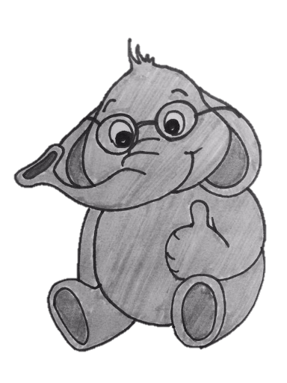
Learning Software Constraints via Installation Attempts
Ran Ben Basat, Harvard University
Joint work with Maayan Goldstien and Itai Segall (Nokia Bell Labs)
1

Slide 2
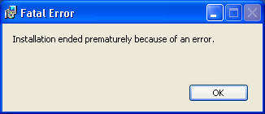
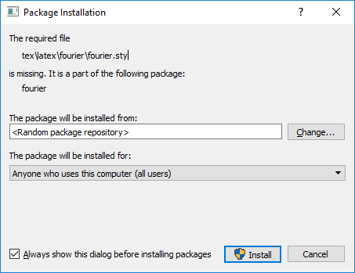
Automatic Installers

Slide 3
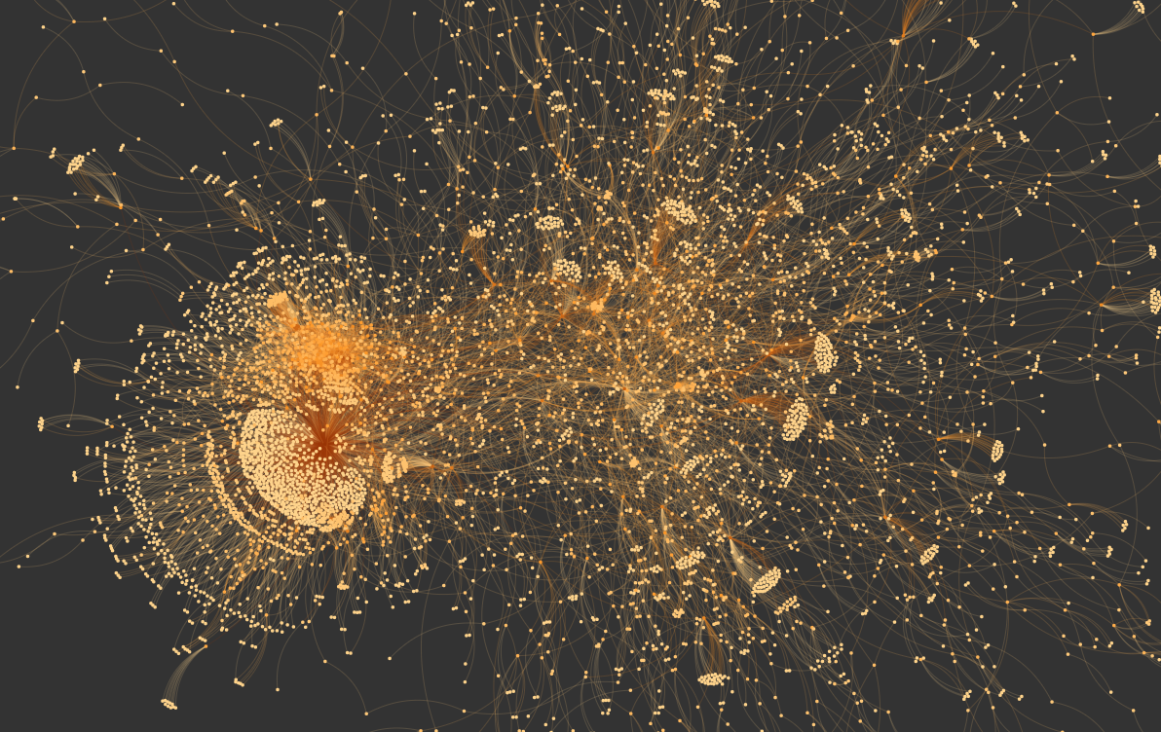
Dependency Hell

Slide 4
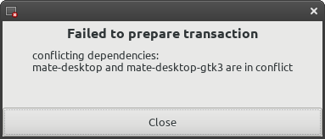
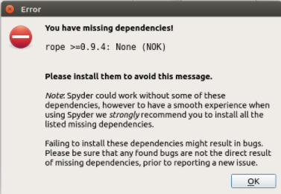
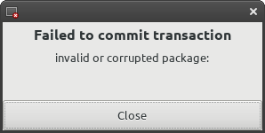
Potential Issues

Slide 5
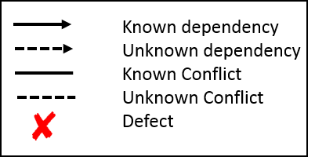
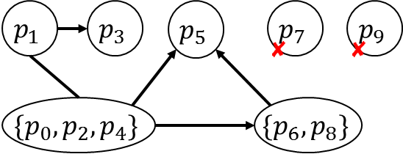
Problem
$$p_{0}$$
$$p_{1}$$
$$p_{0}$$
$$p_{1}$$
$$p_{2}$$
$$p_{3}$$
$$p_{2}$$
$$p_{3}$$
$$p_{4}$$
$$p_{5}$$
$$p_{4}$$
$$p_{5}$$
$$p_{6}$$
$$p_{7}$$
$$p_{6}$$
$$p_{7}$$
$$p_{9}$$
$$p_{8}$$
$$p_{9}$$
$$\{p_{0},p_{2}\}$$
$$p_{8}$$
$$\{p_{0},{p_{2},p}_{4}\}$$
$$\{p_{0},p_{1},{p_{2},p}_{4}\}$$
…

Slide 6
Learning and NP-hardness
We only measure query complexity.
Given the final graph, one may need to compute a Maximum Independent Set – an NP-hard problem!
Usually not a problem in practice.
43 seconds to solve the 34.7K sized Debian pool snapshot.
Mancinelli et al. ASE 2006.

Slide 7
How many queries?
Naively, we would need $2^{n}$ queries to determine all properties of a $n$-sized repository.
We say that an algorithm is efficient if it requires $O\left(\log{n}\right)$ queries for constant many unknowns.

Slide 8
Learning Algorithms
Two types:
Non-Adaptive – computes a set of tests, collect feedbacks and infer the output.
Adaptive – runs a test, collect its feedback and use it to decide on the next one.

Slide 9
Finding defects given known dependencies
Known dependency
At most $r$ root defects
Root defect
Is there an efficient algorithm?

Slide 10
Group Testing (Dorfman, 1943)
Designed to identify syphilitic soliders in the US army during WW2.
By mixing blood from several soliders we can learn if at least one is infected.

Slide 11
Generalized Binary Splitting (Hwang, 1972)
FindInfected($S)$
Let $A$ be an $|S|/2$ sized subset of $S$
If $A$ is infected
FindInfected($A$)
FindInfected($S\backslash A$)
MainProcedure ($S,d$)
Let $A$ be an $≈|S|/2d$ sized subset of $S$
If $A$ is infected
$x$ = FindInfected($A$)
MainProcedure($S\backslash \{x\},d−1)$
MainProcedure($S\backslash A,d)$
Requires at most $d−1$ more queries than the information theoretic lower bound!

Slide 12
Finding defects given known dependencies
Known dependency
At most $r$ root defects
Root defect
FindInfected($S)$
Let A be an $|S|/2$ sized subset of S
If A is infected
FindInfected(A)
FindInfected(S\A)
$$A_{1}=\{\left\{a,b\right\},c,d,e\}$$
g
a
c
e
g
c
e
a,b
a,b
$$A_{2}=\{\left\{a,b\right\},c,d,e,f,h\}$$
$$A_{3}=\{\left\{a,b\right\},c,d,e,f\}$$
b
f
d
f
h
i
d
h
i
At most $r−1$queries more than the LB ☺

Slide 13
Lower Bounds for Finding Defects in the Presence of Unknown Dependencies
Unknown dependency
$$a_{1}$$
$$a_{2}$$
…
$$a_{i}$$
$$a_{i+1}$$
$$a_{i+2}$$
…
$$a_{n}$$
Known dependency
Root defect
Defect
At most one unknown dependency and one root defects
At most $u$ unknown dependencies and $d$ defects
No efficient (adaptive) algorithm exists ☹
Defect: a package that cannot be included in a successful installation

Slide 14
Cover Free Families
A $\left(n,a,b\right)−$Cover Free Family $F⊆{\left\{0,1\right\}}^{n}$ is a set of vectors such that:
$$∀S_{1},S_{2}⊆\left\{1,…,n\right\},\left|S_{1}\right|=a,\left|S_{2}\right|=b,\left(S_{1}∩S_{2}\right)=∅⇒∃v∈F:v_{|S_{1}}=0,v_{|S_{2}}=1$$
0 | 0 | 1 | 0 | 1
0 | 1 | 1 | 0 | 0
1 | 0 | 0 | 0 | 1
0 | 1 | 0 | 0 | 1
0 | 0 | 0 | 1 | 1
0 | 0 | 1 | 1 | 0
1 | 0 | 1 | 0 | 0
0 | 1 | 0 | 1 | 0
1 | 0 | 0 | 1 | 0
1 | 1 | 0 | 0 | 0
$$n=5$$
$$a=2$$
$$b=2$$

Slide 15
On the Size of Cover Free Families
Consider $n=30, a=2, b=2$
${>10}^{9}$ subsets
$\left(\begin{aligned}30 \\ 2,2\end{aligned}\right)=164430$ pairs of $S_{1},S_{2}$ subsets
There exists a 98-sized CFF
We can randomly draw a $300$-sized vector-set and get a CFF with probability $≥99.9\%$.
In general –
$$S_{n,a,b}=\left(\begin{aligned}a+b \\ b\end{aligned}\right){\left(a+b\right)}^{1±o\left(1\right)}⋅\log{n}≤2^{a+b}\log{n}$$

Slide 16
The security update problem
Can we determine the largest possible installable package set?
Without conflicts, this is equivalent to identifying all defects.

Slide 17
Lower Bounds for Finding Defects in the Presence of Unknown Dependencies
At most $u$ unknown dependencies and $d$ defects
Thm: at least $S_{n,d−1,u+1}$ queries are needed non-adaptively
Unknown dependency
Defect
$$x_{1}$$
$$a_{1}$$
$$x_{2}$$
$$a_{2}$$
…
…
$$p$$
$$x_{d−1}$$
$$a_{u}$$
$$P\backslash S_{1}\backslash S_{2}$$
$$S_{1}$$
$$S_{2}$$

Slide 18
Non-Adaptive Defect Finding in the Presence of Unknown Dependencies
Thm: $S_{n,d,u+1}$ queries are enough
Thm: at least $S_{n,d−1,u+1}$ queries are needed
Known dependency
Unknown dependency
Defect
$$p_{1}$$
$$p_{2} …$$
$$p_{5}$$
0 | 0 | 1 | 0 | 1
0 | 1 | 1 | 0 | 0
1 | 0 | 0 | 0 | 1
0 | 1 | 0 | 0 | 1
0 | 0 | 0 | 1 | 1
0 | 0 | 1 | 1 | 0
1 | 0 | 1 | 0 | 0
0 | 1 | 0 | 1 | 0
1 | 0 | 0 | 1 | 0
1 | 1 | 0 | 0 | 0
0 | 0 | 1 | 1 | 1
0 | 1 | 1 | 1 | 1
1 | 1 | 0 | 0 | 1
0 | 1 | 0 | 0 | 1
0 | 0 | 0 | 1 | 1
0 | 0 | 1 | 1 | 1
1 | 1 | 1 | 1 | 1
0 | 1 | 0 | 1 | 1
1 | 1 | 0 | 1 | 1
1 | 1 | 0 | 0 | 0
$$p_{1}$$
$$p_{2}$$
$$n=5$$
$$u=1$$
$$d=2$$
$$↓$$
$$\left(5,2,2\right)−CFF$$
$$p_{3}$$
$$p_{4}$$
$$p_{5}$$
Propagate known dependencies
Claim:
If $p$ is not defective, then it is included in a successful test.

Slide 19
Adding Conflicts to the Mix
Identifying defects not enough even for solving the security update problem ☹.
More bad news:
Even learning a single dependency cannot be done efficiently, even if no defects or conflicts exist!
Unknown dependency
$$a_{1}$$
$$a_{2}$$
…
$$a_{i}$$
$$a_{i+1}$$
…
$$a_{n}$$
Known dependency
1
1
1
0
0
1
1
1
0
0

Slide 20
LEARNING CONFLICTS WHEN ALL DEPENDENCIES ARE KNOWN
Even More bad news:
Even learning a single conflict cannot be done efficiently, even if no defects exist and all dependencies are known!
1
1
1
0
0
$$a_{1}$$
$$a_{2}$$
…
$$a_{i}$$
$$a_{i+1}$$
…
$$a_{n−1}$$
Weak Conflict
Unknown Conflict
Known dependency
$$p$$
1
Weak conflict: two packages weakly conflict if they cannot be successfully install together.

Slide 21
LEARNING CONFLICTS WHEN ALL DEPENDENCIES ARE KNOWN
Thm. Assume that the repository contains at most d defects and c unknown weak conflicts.
Any non-adaptive algorithm that solves Full Learning must make at least $S_{n,d+c−1,2}$ queries.
Legend:
Conflict
$$q$$
Defect
$$x_{1}$$
$$b_{1}$$
$$b_{2}$$
$$x_{2}$$
?
…
…
$$p$$
$$x_{d}$$
$$b_{c−1}$$
$$S_{2}$$
$$P\backslash S_{1}\backslash S_{2}$$
$$S_{1}$$

Slide 22
LEARNING CONFLICTS WHEN ALL DEPENDENCIES ARE KNOWN
Thm. Assume that the repository contains at most d defects and c unknown weak conflicts. Any non-adaptive algorithm that solves Full Learning must make at least $S_{n,d+c−1,2}$ queries.
Thm: There exists a non-adaptive algorithm that makes $S_{n,d+c,2}$ queries.
Adaptive algorithms can get a $d^{2+o\left(1\right)}$ dependency!
The non-adaptive dependency on the number of defects is $d^{3±o\left(1\right)}$
Use $S_{n,d+c−1,1}$ queries to learn all defects and another $S_{n,c,2}$ to learn conflicts.

Slide 23
From Theory to Practice?
We have that for $a=Θ\left(b\right):$
$$\sum_{i=1}^{a}{\sum_{j=1}^{b}{S_{n,i,j}}}={\left(S_{n,a,b}\right)}^{O\left(1\right)}$$
$⇒$ We can start with $a=b=1$ and increment their value till we run out of query budget

Slide 24
Any Questions

Slide 25
Summary
If all dependencies are known and no conflicts exist, then there exists an efficient solution if the number of root defects is small.
If some dependencies are not known and no conflicts exist, then there exists an efficient solution if the number of dependencies and defects is small.
In the paper: lower bounds and efficient algorithms for discovering conflicts.

Slide 26
Any Questions

Slide 27
Any Questions

Slide 28
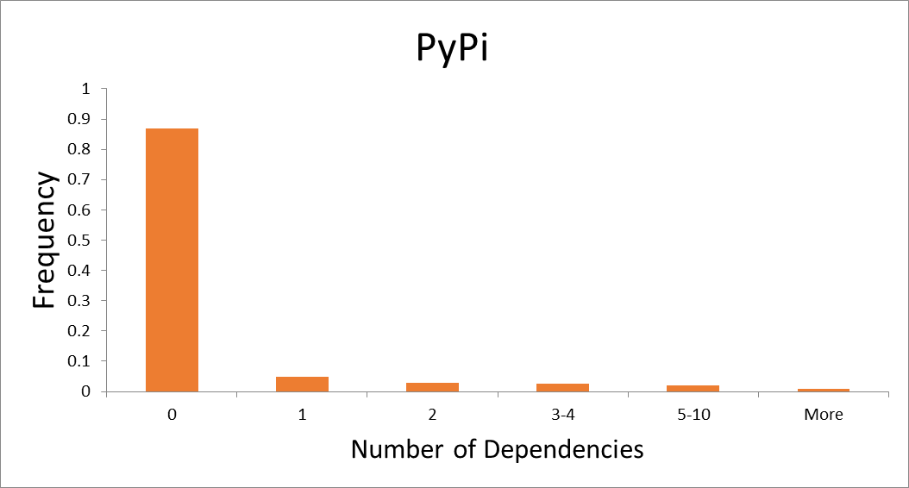
Can adaptivity help?
Thm: at least $S_{n,d−1,u+1}$ queries are needed…
for adaptive algorithms as well ☹
For example..
if $n=37400, a=b=12, x=1$
$4⋅{10}^{9}$ queries are needed non-adaptively
${2⋅10}^{6}$ queries are needed adaptively
What if we assume that each package has unknown dependencies on only a small fraction of the packages?
Thm: at least $S_{n,d−1,u+1}$ queries are required unadaptively even if each package depends on at most one unknown package
Thm: if we assume that each package (immediately) depends on at most $x$ packages, ${\frac{u}{x}S}_{n,d+u−x,x+1}$
queries are enough
$$p$$
$$p$$
$$p$$
$$p$$
$$<1\%$$

Slide 29
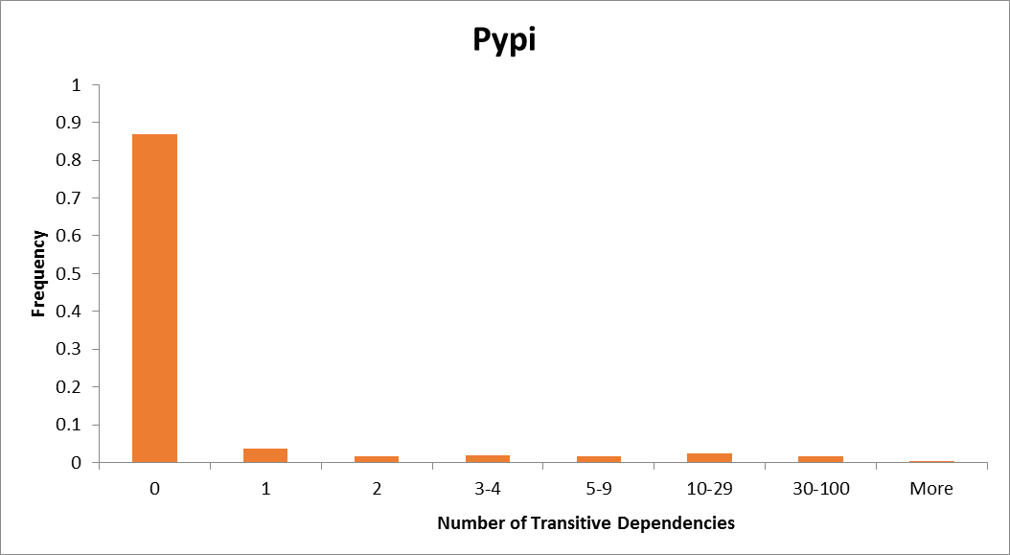

Slide 30
Model
A mixed graph $G=(P,C,K ∪U)$
$P$ is the set of packages
$C$ is the set of unknown conflicts
$K$ is the set of known dependencies
$U$ is the set of unknown dependencies
$D⊆P$ is the set of unknown defects
$D,C$ and $U$ are small

