Slide 1
PINT: Probabilistic In-band Network Telemetry
Ran Ben Basat, Harvard University
Joint work with Sivaram Ramanathan, Yuliang Li (Harvard), Gianni Antichi (QMUL), Minlan Yu, Michael Mitzenmacher (Harvard)
1
Notes:
Hi Everyone, thanks for joining.
Today I’ll be presenting our probabilistic approach for in-band network telemetry.
And this work is really enabled by this new trend of programmable network components we are now seeing

Slide 2
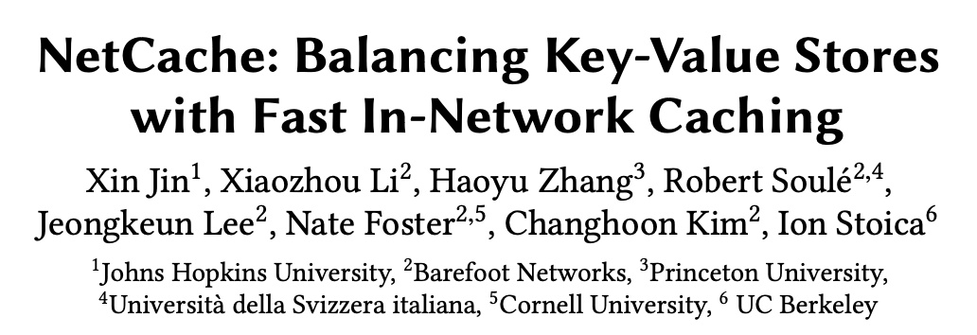
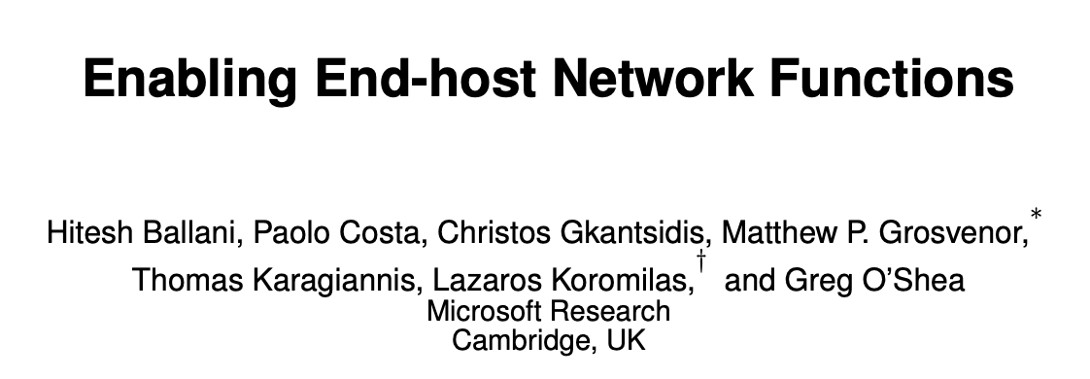
The rise of programmable devices
2
Notes:
We have now programmable switches and smartnics from many different vendors,

Slide 3
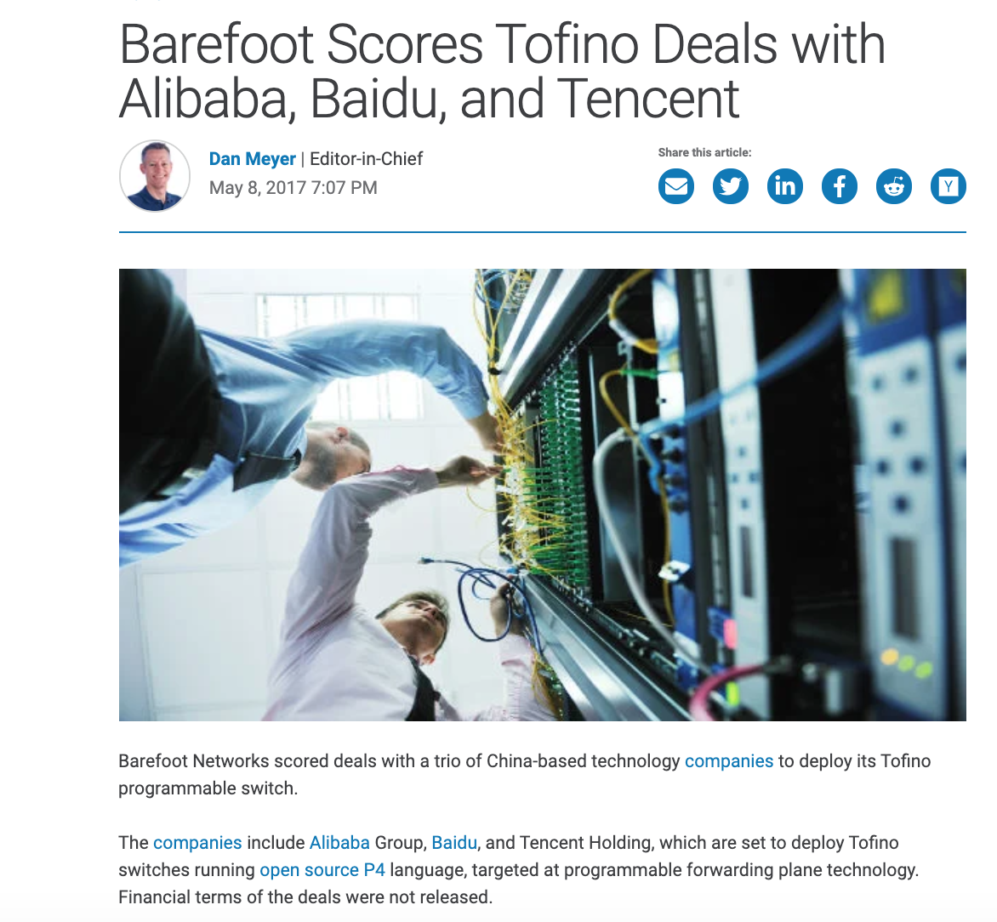
Programmable Data Planes: not an academic dream
3
Notes:
But this is not just an academic game, we now have smartnics deployed in the public cloud

Slide 4
Killer App: Network Telemetry
Tell me more about my packets.
Is there a congestion/queue buildup?
Do routing paths agree with the policy?
Can flow $x$ increase its sending rate?
4
Notes:
So, one of the selling point for these switches is the new and exciting telemetry capabilities.
And telemetry is about knowing my network status.
For example, we want to know if there’s a queue buildup somewhere that is causing congestion, if all routes agree with the policy (e.g., we may want all flows to go through a firewall), and we can even use telemetry to know whether a flow can safely increase its sending rate without causing congestion at any point.

Slide 5
INT: In-band Network Telemetry
Packet
Header
INT
Packet Payload
Add hop information (e.g., switch ID) onto the packet
INT Source
Packet
Header
Packet Payload
INT
INT header
INT metadata value
INT header
Packet
Header
Packet Payload
INT
5
Packet
Header
Packet Payload
INT
INT metadata value
INT header
INT metadata value
INT header
INT metadata value
Notes:
To that end, we have the INT, or In-band Network Telemetry, protocol.
The idea is conceptually simple. If we want to collect date from the network, we can just add it to data packets.
For example, say that we want to discover the path taken by a flow, i.e., collect the switch IDs along the path.
In this case, the first participating hop (which can be either the end host or an ingress switch), which is also called the INT source, adds a new INT header that tells all switches along the path which information we are collecting (i.e., the switch ID). It then adds its own ID, and send the packet to the next hop.

Slide 6
INT: In-band Network Telemetry
Packet
Header
INT
Packet Payload
Add hop information (e.g., switch ID) onto the packet
INT Source
Packet
Header
Packet Payload
INT
INT header
INT metadata value
INT header
Packet
Header
Packet Payload
INT
6
Packet
Header
Packet Payload
INT
INT metadata value
INT header
INT metadata value
INT header
INT metadata value

Slide 7
INT: In-band Network Telemetry
Packet
Header
INT
Packet Payload
Add hop information (e.g., switch ID) onto the packet
INT Source
Packet
Header
Packet Payload
Packet Payload
Packet
Header
INT
INT
INT header
INT metadata value
INT metadata value
INT metadata value
INT header
INT header
Packet
Header
Packet Payload
INT header
INT
7
Packet
Header
Packet Payload
INT
INT metadata value
INT header
INT metadata value
INT header
INT metadata value
Notes:
The next hop reads the INT header, figures out we are collecting switch IDs, adds its own and forwards the packet.

Slide 8
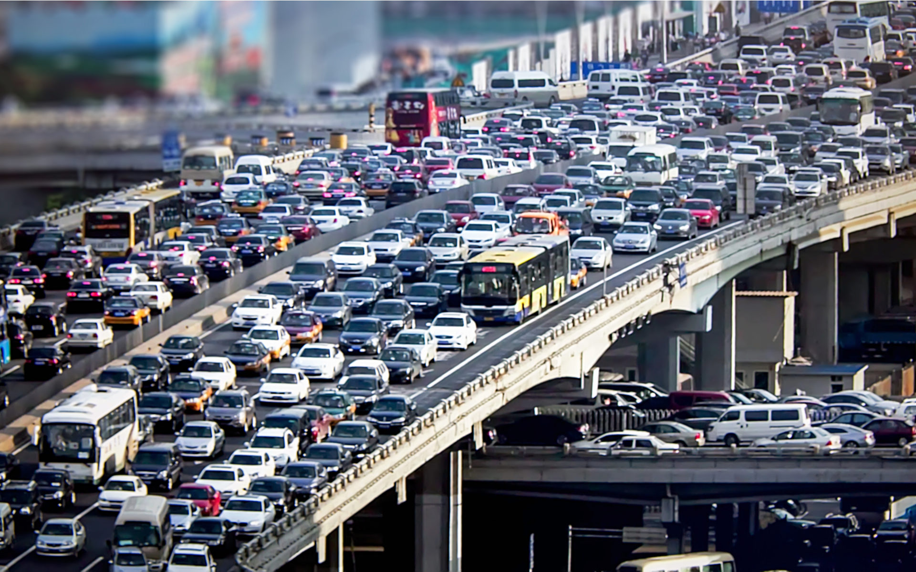
Telemetry Use case #1 – Congestion Control
State of the art: High Performance Congestion Control (HPCC, SIGCOMM 2019) is deployed in production in Alibaba.
8

Slide 9
Telemetry Use case #2 – Path Discovery
Which path do my packets take?
Which rules do my packets follow?
Barefoot
Advanced Network Telemetry
Does the path conform with the operator’s policy?
9

Slide 10
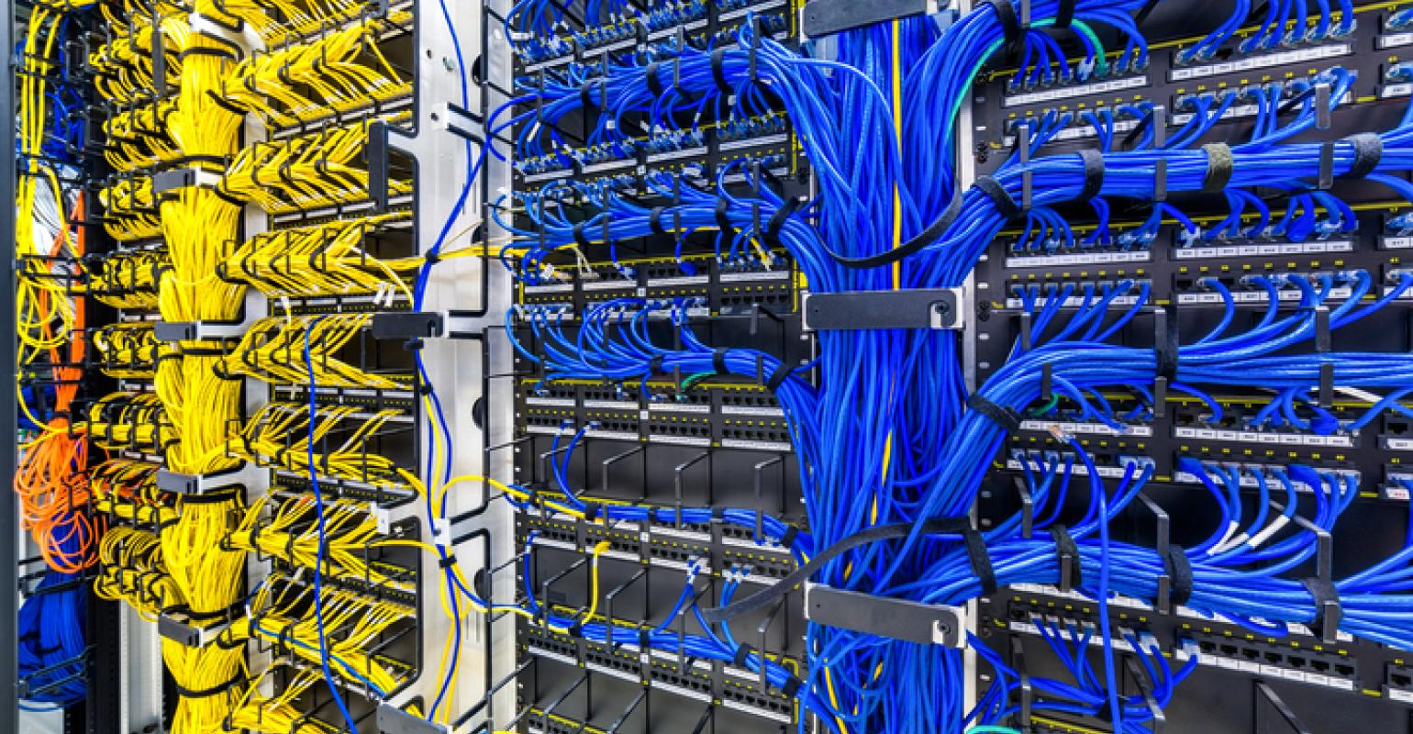
Telemetry Use case #3 – Network Debugging
Identify switches/links with high latency.
Discover load imbalance.
10

Slide 11
INT: In-band Network Telemetry
INT is general
Supports a large variety of functions including latency and buffer measurements.
INT is deployed in major companies such as Alibaba in production.
But introduces high packet overheads.
A single function (e.g., switch ID), adds 4 bytes per hop.
Overhead grows multilinearly with the path length and number of collected telemetry types.
11
Notes:
Add company icons
Discuss use cases here

Slide 12
INT: In-band Network Telemetry
Issue III: High packet overheads degrade application performance.
Packet
Header
Packet Payload
Packet
Header
Packet Payload
INT
Without INT
With INT
12
Notes:
Add company icons
Discuss use cases here

Slide 13
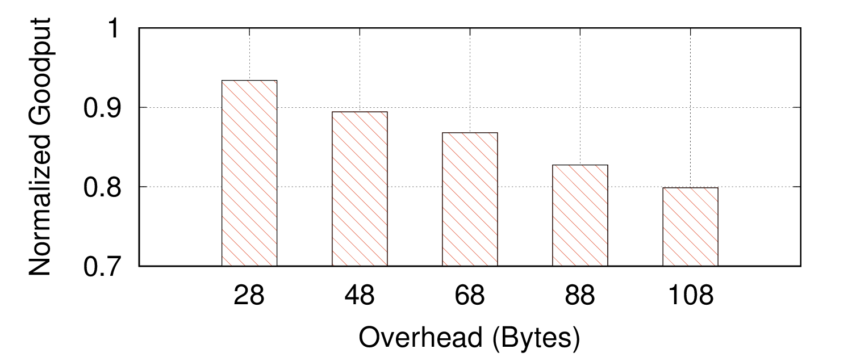
INT Drawbacks
Issue III: High packet overheads degrade application performance.
Path Tracing
HPCC
Both
13
Notes:
5-hop, fat tree, 64 hosts, web search workload, all are standard

Slide 14
INT Drawbacks
Issue III: High packet overheads degrade application performance.
Issue III: High packet overheads
I
Issue III: High packet overheads increase switch processing time.
Approximately 1% increase per telemetry type on 10G link
INT
Payload
Payload
14
Notes:
Add company icons
Discuss use cases here

Slide 15
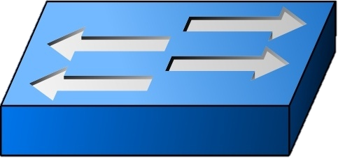
INT Drawbacks
Issue III: High packet overheads
I
Issue III: High packet overheads impose severe collection costs.
Issue III: High packet overheads increase switch processing time.
High network overheads.
High processing overheads.
State of the art telemetry processing (e.g., Confluo, NSDI 2019) rely on fixed byte-size data and are incompatible.
15
Notes:
Add company icons
Discuss use cases here

Slide 16
PINT: Probabilistic In-band Network Telemetry
Goal: encode telemetry information on packets while minimizing the bit-overhead.
Values: when a packet $p_{j}$ reaches switch $s_{i}$, the switch observes a value $v(p_{j},s_{i})$.
Insight: most applications do not need all per-packet per-switch values, but aggregated data.
Implementation: P4 code.
16

Slide 17
PINT: Probabilistic In-band Network Telemetry
Per-packet aggregation:
For each $p_{j}$, aggregate (e.g., max/min/sum/product) the values along its path.
Per-flow aggregation: For a flow with packets $p_{1},p_{2},…$
Static Case
Dynamic Case: for each switch on the path, aggregate (e.g., estimate the median) over $v\left(p_{1},s\right),v\left(p_{2},s\right),….$
: compute $v(p_{1},s)$ for each switch on the path.
Switches
Packets
Per-packet
$$p_{1}$$
Output $f( )$
Static Per-flow
$$p_{2}$$
Output
$$…$$
Dynamic Per-flow
$$g( )$$
$$g( )$$
$$g( )$$
$$g( )$$
17
Notes:
Visualize

Slide 18
Techniques
Global hash functions allow implicit switch agreement, e.g., on the query type.
Approximations can reduce bit-overhead for numerical values.
Coding helps reduce spreading out static information on multiple packets.
18

Slide 19
PINT solves the overhead issues
The lower overhead reduces the goodput degradation significantly.
By lowering the packet overhead, PINT reduces the switch processing time.
PINT produces less information with fixed-size packet digests and reduces the collection overheads.
19
Notes:
Visualize

Slide 20
Why should we use a probabilistic approach?
Reduces the bit-overhead added to packets, at the cost of approximation.
Different forms of approximation:
Numerical approximation
We mostly care about significant latencies or changes
Requiring multiple packets
Flows typically have multiple packets, and a few packets suffice for significant savings
20

Slide 21
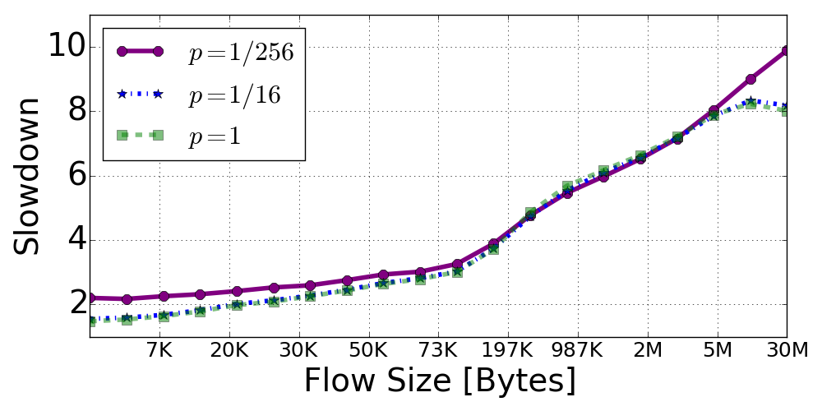
Use case 1: Congestion Control (per-packet aggregation)
The HPCC congestion control algorithm (SIGCOMM 2019) uses INT.
PINT moves the computation to the data plane to allow tracking just the maximum (i.e., the bottleneck).
PINT uses probabilistic rounding, to get the right signal in expectation.
PINT can probabilistically decide if to act on a packet.
$$\tilde{f\left(\overline{q_{1}}\right)}$$
$$\tilde{f\left(\overline{q_{2}}\right)}$$
$$\tilde{f\left(\overline{q_{3}}\right)}$$
$$\tilde{f\left(\overline{q_{4}}\right)}$$
$$\overline{q_{1}}$$
$$\overline{q_{2}}$$
$$\overline{q_{3}}$$
$$\overline{q_{4}}$$
$$R=max \{f\left(\overline{q_{i}}\right)\}$$
21
Notes:
"
HPCC computes what would be the rate that could cause congestion in each link along the path, and selects the best rate to avoid overloading the bottleneck.
We move the computation of the link sending-rate to the switches, which then allows us to store only the bottleneck’s statistics on the packet and not collect all the queueing statistics."
Then, when talking about the randomized rounding:
"We quantize the rate information into a small number of bits, probabilistically round the result so that the end-host will get the right sending rate in expectation. This means that a single packet may have slightly inaccurate feedback, but over multiple packets, this error cancels out and we converge to the right rates."
And when talking about the 1/16 sampling: "PINT may also use only some packets to deliver the feedback. The intuition is that we still get multiple feedbacks per RTT, which allows HPCC to work properly".

Slide 22
Use case 2: Path Discovery (static per-flow aggregation)
$v\left(p_{j},s\right)=ID_{s}$
Baseline solution: write a sampled ID on each packet.
We can use the TTL field to get the hop number and run Reservoir Sampling (Sattari et al., 2010).
A
B
C
D
C
A
A
D
A
C
B
A Coupon Collector process. For $k$ hops it will take $\operatorname{kln}{k}(1+o\left(1\right))$ packets to detect the path.
22
Notes:
RS allows us to get exact uniform distribution even though switches don’t know the path length
Static case is a generalization

Slide 23
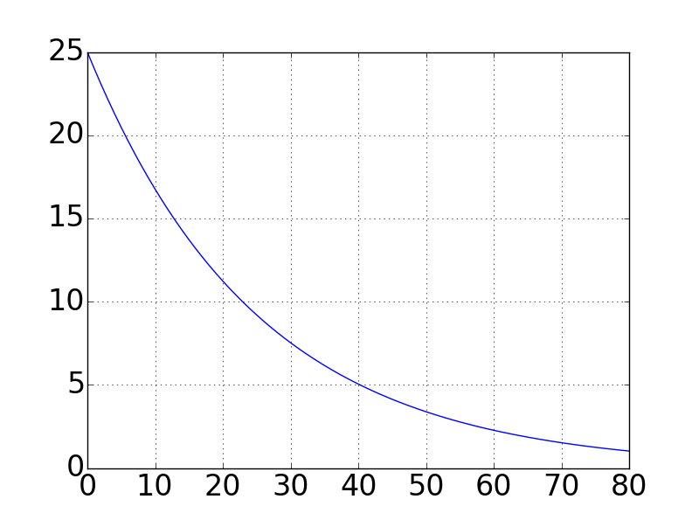
Coupon Collector Process
$$k=$$
$$𝔼[missing$$
$$hops]$$
Number of samples
23
Notes:
In some topologies, we may do better

Slide 24
The power of Coding
A
B
The Baseline would:
Get information on the first packet.
Require 2 packets on average to get the second hop ID.
Overall: $1+2=3$ packets in expectation.
$$A$$
$$A$$
$$B$$
Consider baseline sampling with probability 0.5, and writing $A⊕B$ otherwise.
If the first packet is an ID (e.g., $A$), we need $4/3$ more packets on average.
Overall: $1+\frac{4/3+2}{2}=8/3$ packets in expectation.
$$A$$
𝐴⊕𝐵
24

Slide 25
Path Profiling – the XOR algorithm
Assumptions:
We know a “typical” length $d=Θ(k)$.
Packets have unique identifiers.
Each switch XORs its identifier w.p. $p$.
Sample according to a global hash function $h(TTL,p_{j})$
A
B
C
D
$$\{1,2\},A⊕B$$
$$\{3\} ,C$$
$$\{\},0$$
$$\left\{3,4\right\},C⊕D$$
25

Slide 26
Path Profiling – the XOR algorithm
Assumptions:
We know a “typical” length $d=Θ(k)$.
Packets have unique identifiers.
Each switch XORs its identifier w.p. $p$.
Sample according to a global hash function $h(TTL,p_{j})$
A
B
C
D
$$\{1,2\},A⊕B$$
$$\{3\} ,C$$
$$4=(C⊕D)⊕C=D$$
$$\{\},0$$
$$\left\{3,4\right\},C⊕D$$
26
Notes:
ID can be 5-tuple / IPID / TCP seq / etc.

Slide 27
Improving the Coupon Collector
Baseline
XOR$\left(\frac{1}{5}\right)$
XOR$\left(\frac{1}{2}\right)$
$$𝔼[missing$$
$$hops]$$
Number of samples
27

Slide 28
Complete Algorithm
With probability $τ$, run the coupon collector algorithm.
Otherwise, choose one XOR layer at random.
The XOR instances have increasing probabilities.
Performance Guarantee: $k⋅(log{\log^{∗}{k}}+2+o(1))$ packets suffice.
$$…$$
XOR2
XOR1
Coupon collector
28
Notes:
Add a results slide

Slide 29
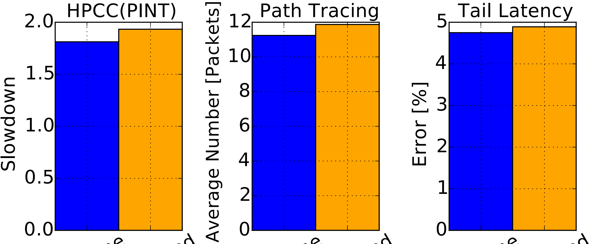
Also in the paper
Algorithms for dynamic aggregation.
Performance guarantees.
Support for concurrent queries.
Standalone
Concurrent
Standalone
Concurrent
Standalone
Concurrent
29

Slide 31
Path Tracing
31

Slide 32
Any Questions
32

Slide 33
Any Questions

Slide 34
Any Questions

Slide 35
What to do?
IEEE ICNP 2018
Leveraging Emerging Hardware Technologies
Approximate Measurements
IEEE INFOCOM 20
IEEE/ACM ToN 19
ACM/IEEE ANCS 18
IEEE INFOCOM 18
IEEE INFOCOM 17
IEEE INFOCOM 16
…
This Talk
SIGMETRICS 2020
VLDB 2019
Designing Expressive Algorithms
Redesigning Algorithms for Speed
ACM SIGCOMM 19
IFIP NETWORKING 19
ACM CoNEXT 18
ACM ICDCN 18 best paper
IEEE MASCOTS 18
ACM SIGCOMM 17
IEEE INFOCOM 17
35

Slide 36
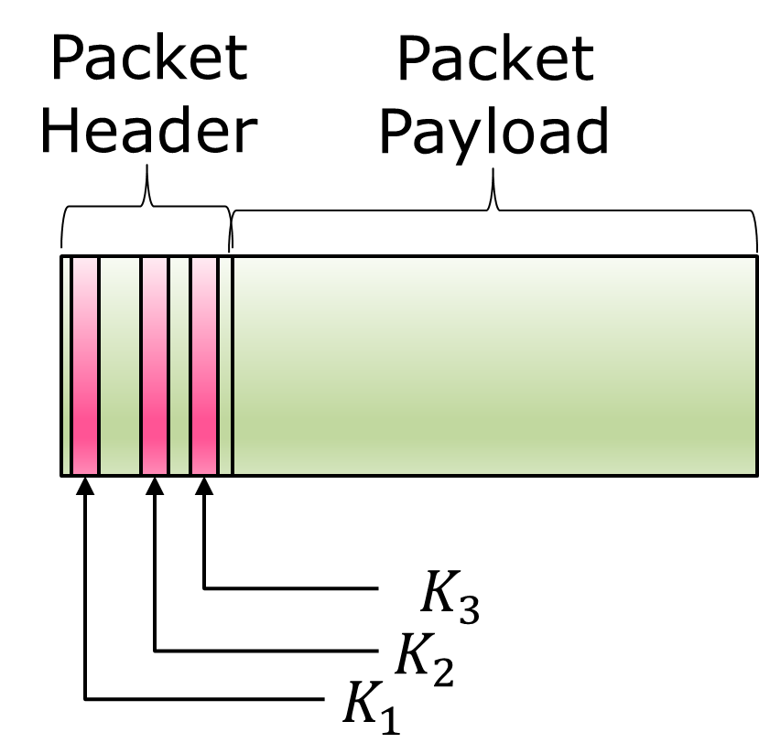
Packet
Header
Packet Payload
$$K_{3}$$
$$K_{2}$$
$$K_{1}$$

Slide 37
PISA Programmable Switch (Protocol Independent Switching Architecture)
Stateful Memory
1 | 2 | 3 | 4
1 | 0 | 1 | 0
1 | 2 | 3 | 4
1 | 2 | 3 | 4
1
K₁ | V₁
K₂ | V₂
K₃ | V’
K₄ | V”
K₅ | V”
K₁ | V₁
K₂ | V₂
K₃ | V₃
01011010…
Parser
Match-Action pipeline
Deparser
01011010…
Notes:
A brief overview of PISA switch…
Pipe goes one way. Once next stage, can’t go back. If you want to go back, may recirculate, but need to do again.
-> what is recirculation? Bring back… visit every stage a second time. Obviously it’s very expensive to do this for many packets, hurts throughput.
Recirculation: what we focus on today
PISA switch is real, “practical”, on the market, already widely used today in data centers (for quick iteration / deployment of new network functionality)
Barefoot Tofino.

Slide 38
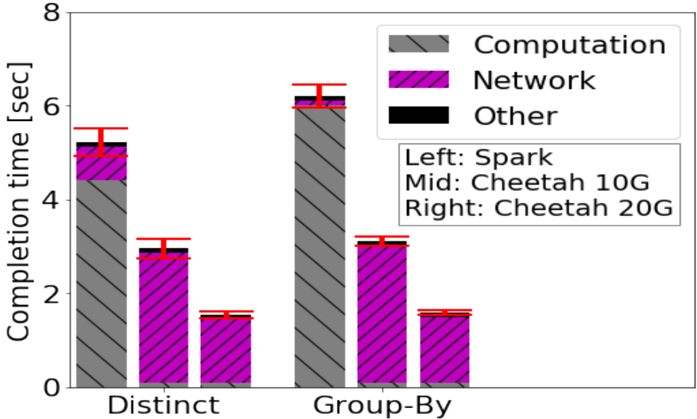
Database Queries in Spark
Multiple workers parallelize the data processing
Processing user-defined functions (UDFs) at workers
Query
Plan
Query, UDF
Query planner
Master Node
Switch
Worker
UDF
Data
User
Result
Data
38

Slide 39
Database Queries in Spark
Multiple workers parallelize the data processing
Processing user-defined functions (UDFs) at workers
Query
Plan
Query, UDF
Query planner
Master Node
Switch
Worker
UDF
Data
User
Result
Data
39

Slide 40
INT: In-band Network Telemetry
Packet
Header
INT
Packet Payload
df
INT Source
INT Target
Packet
Header
Packet Payload
Packet
Header
Packet Payload
Packet
Header
Packet Payload
INT
INT
INT
INT header
INT metadata value
INT metadata value
INT header
INT header
INT header
40
INT metadata value

Slide 41
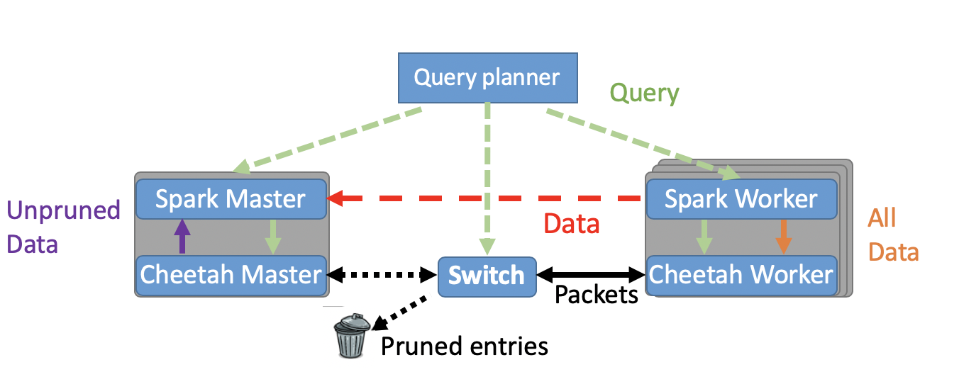
Query Planner
Spark Master
Spark Worker
Unpruned Data
All Data
Cheetah Master
Switch
Cheetah Worker
Packets
Pruned Entries
41

Slide 43
INT: In-band Network Telemetry
df
Packet
Header
INT
Packet Payload
INT metadata value
INT header
43

Slide 44
INT: In-band Network Telemetry
df
INT Source
INT Sink
Packet
Header
Packet Payload
Packet
Header
Packet Payload
INT
INT
INT metadata value
INT metadata value
INT header
INT header
44
Notes:
BAK

Slide 45
Also in the paper
Pruning algorithms for Join, Skyline, Groupby, Having, …
A network protocol that ensures reliability
Support for compound queries
Extensions to multiple switches and a DAG of tasks
45

Slide 46
Path Profiling – the XOR algorithm
Assumptions:
We know a “typical” length $d=k/c$ for some $c=Θ(1)$.
Packets have unique identifiers.
Each switch XORs its identifier w.p. $p=1/d$.
According to a global hash function $h(TTL,p_{j})$
A
B
C
D
$$\{1,2\},A⊕B$$
$$\{3\} ,C$$
$$4=(C⊕D)⊕C=D$$
$$\{\},0$$
$$\left\{3,4\right\},C⊕D$$
46

Slide 47
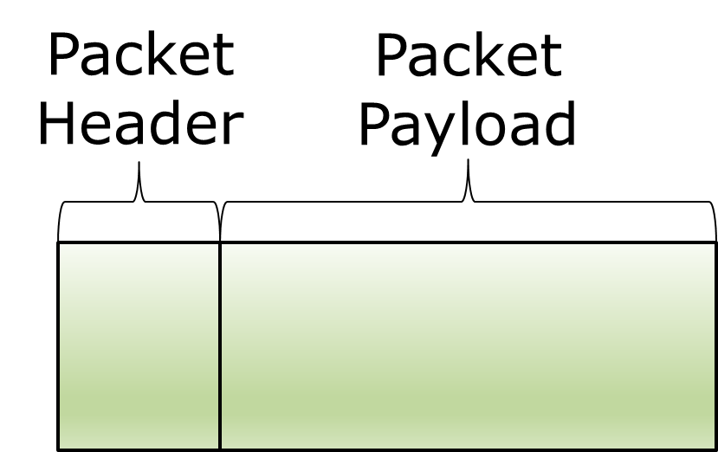
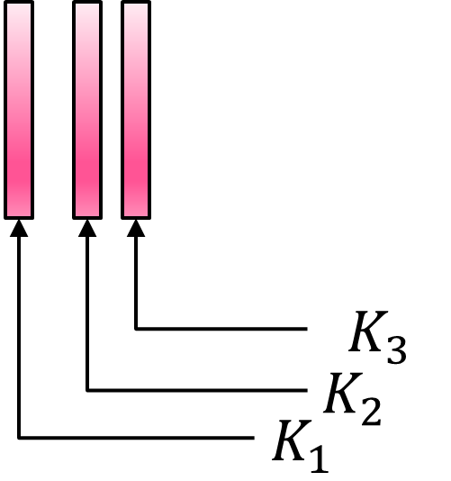
PISA Programmable Switch (Protocol Independent Switching Architecture)
K₁ | V₁
K₂ | V₂
K₃ | V’
K₄ | V”
K₅ | V”
K₁ | V₁
K₂ | V₂
K₃ | V₃
Deparser
Parser
Notes:
A brief overview of PISA switch…
Pipe goes one way. Once next stage, can’t go back. If you want to go back, may recirculate, but need to do again.
-> what is recirculation? Bring back… visit every stage a second time. Obviously it’s very expensive to do this for many packets, hurts throughput.
Recirculation: what we focus on today
PISA switch is real, “practical”, on the market, already widely used today in data centers (for quick iteration / deployment of new network functionality)
Barefoot Tofino.

Slide 48
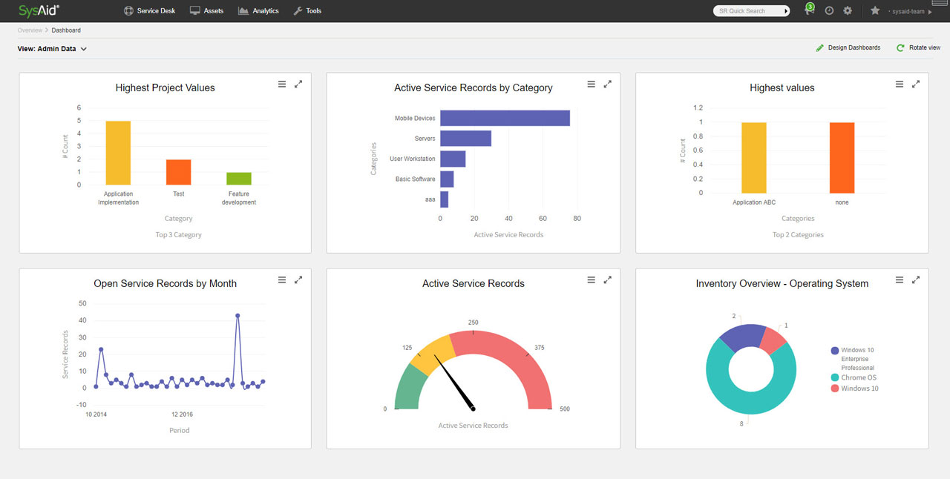
Network Operators Require Better Telemetry
48

Slide 49
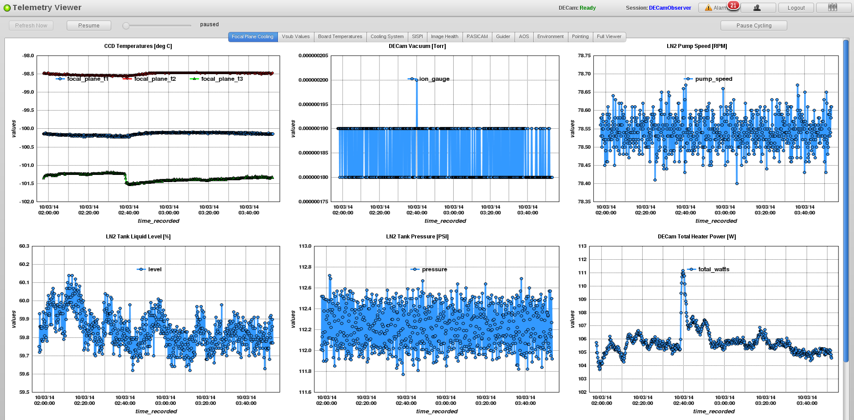

Slide 50
More bandwidth, faster computation
50

Slide 51
Path Profiling – the XOR algorithm
Assumptions:
We know a “typical” length $d=Θ(k)$.
Packets have unique identifiers.
Each switch XORs its identifier w.p. $p=1/d$.
According to a global hash function $h(TTL,p_{j})$
A
B
C
D
$$\{1,2\},A⊕B$$
$$\{3\} ,C$$
$$4=(C⊕D)⊕C=D$$
$$\{\},0$$
$$\left\{3,4\right\},C⊕D$$
51

Slide 52
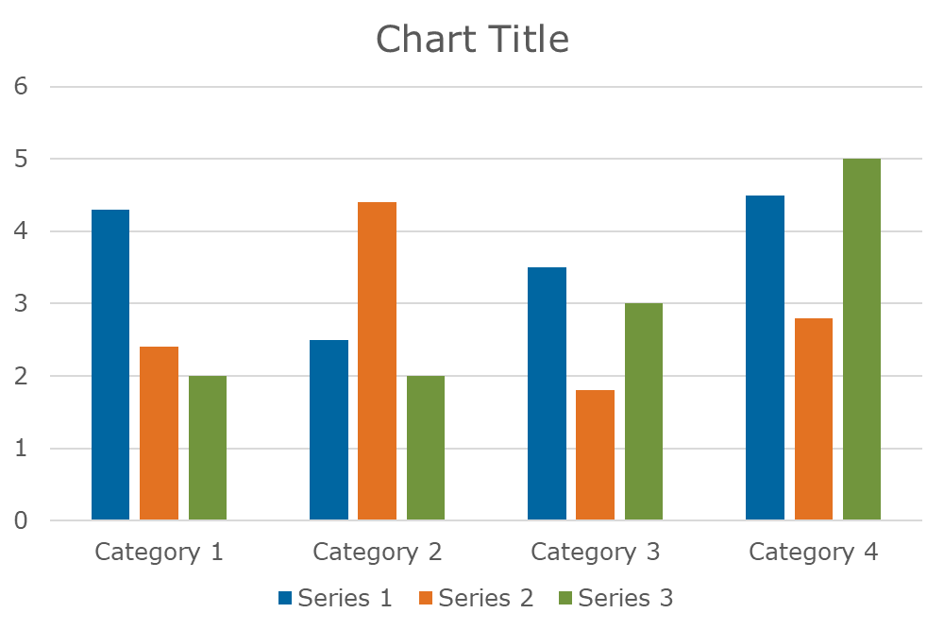

Slide 53
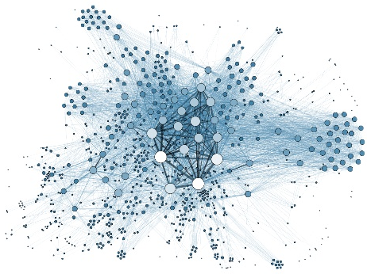
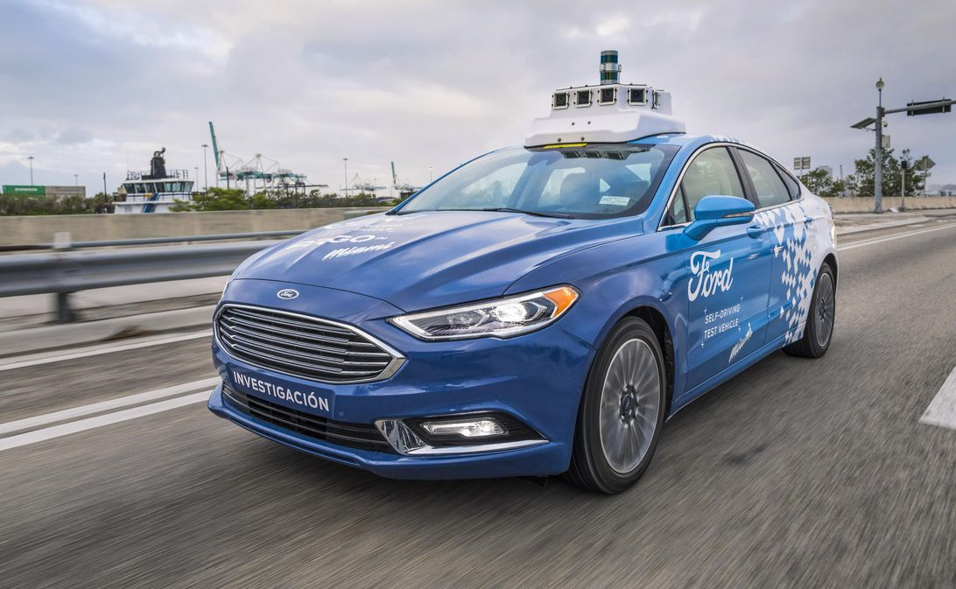
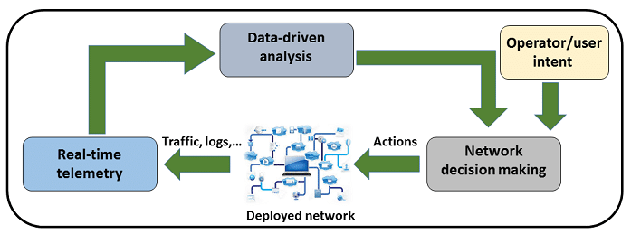
Making more out of data
More complex/diverse queries
Database queries
Graph Mining
Fine-grained Network Telemetry

Slide 54
Key Challenges
Limited Amount of Fast Memory
Data Growth
Limited Programmability
Complex Queries
Real-time
Limited processing time

Slide 55
Network Operators Require Better Telemetry
Networks become complex, making it hard to diagnose problems.
Self-driving networks require automatic understanding of the link bottlenecks and issues.
Attacks are becoming easy and affordable, which requires fine-grained traffic analysis to mitigate and secure.
55

Slide 56
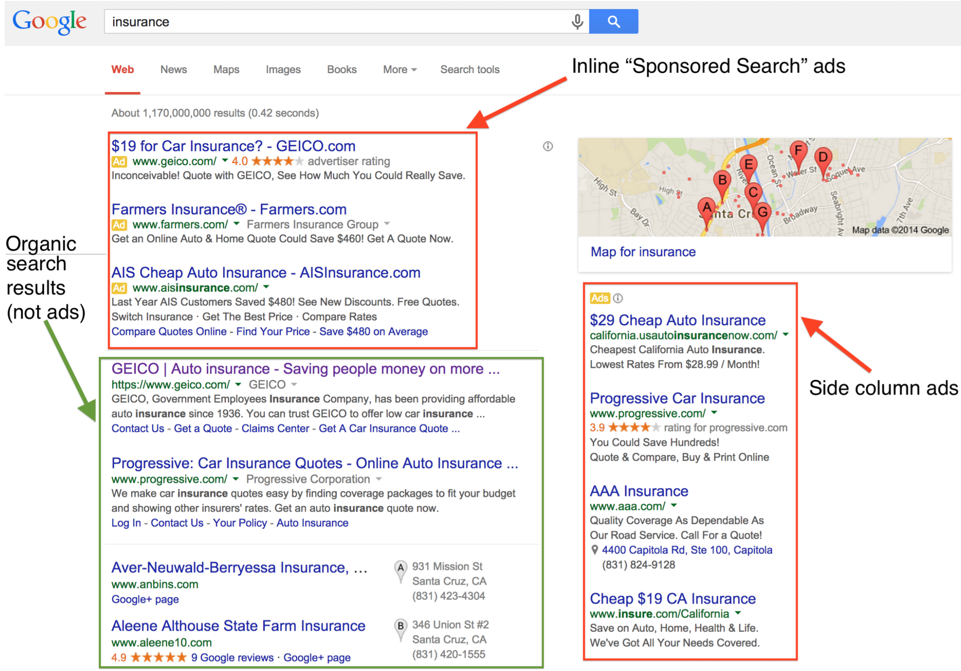
AD 2
AD 3

Slide 57
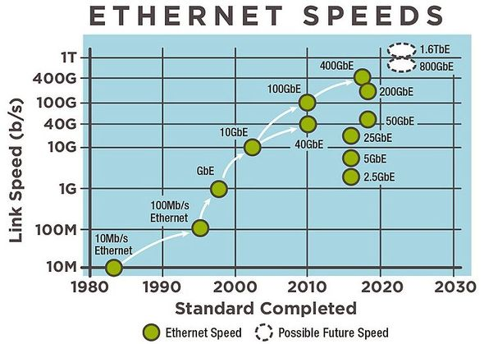
Network Rates are on the Rise
The per-packet processing time is shrinking accordingly
57
Notes:
Ethernet RFC (1984) sets MTU=1500B and is still the most common
Many packets – probabilistic algorithms

Slide 58
What to do?
IEEE ICNP 2018
Leveraging Emerging Hardware Technologies
Approximate Measurement
Algorithms
IEEE INFOCOM 20
IEEE/ACM ToN 19
ACM/IEEE ANCS 18
IEEE INFOCOM 18
IEEE INFOCOM 17
IEEE INFOCOM 16
…
SIGMETRICS 2020
VLDB 2019
Designing Expressive Algorithms
Redesigning Measurement for Speed
ACM SIGCOMM 19
ACM IMC 19
IFIP NETWORKING 19
ACM CoNEXT 18
ACM ICDCN 18 best paper
ACM SIGCOMM 17
IEEE INFOCOM 17
…
58
Notes:
Emphasize that these are my works
There are four directions that we should develop simultaneously and use depending on the use case.

Slide 59
What to do?
IEEE ICNP 2018
Leveraging Emerging Hardware Technologies
Approximate Measurement
Algorithms
IEEE INFOCOM 20
IEEE/ACM ToN 19
ACM/IEEE ANCS 18
IEEE INFOCOM 18
IEEE INFOCOM 17
IEEE INFOCOM 16
…
SIGMETRICS 2020
VLDB 2019
Designing Expressive Algorithms
Redesigning Measurement for Speed
ACM SIGCOMM 19
ACM IMC 19
IFIP NETWORKING 19
ACM CoNEXT 18
ACM ICDCN 18 best paper
ACM SIGCOMM 17
IEEE INFOCOM 17
…
59
Notes:
Emphasize that these are my works
There are four directions that we should develop simultaneously and use depending on the use case.

Slide 60
Key Challenges
Limited Amount of Fast Memory
Data Growth
Limited processing time
Real-time
Complex Queries
Limited Programmability

Slide 61
The end of the Software Approach
“By early 2020s”…
“with super-aggressive efforts, we'll get to the 3nm limit, where features are just 10 atoms across”
Paolo Gargini, Chairman of the IEEE International Roadmap for Devices and Systems
61
Notes:
John Hennessy and David Patterson
ISCA 2018 Turing talk

Slide 62
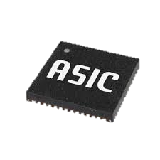
New Opportunities: Specialized Hardware
Specialized hardware to keep up with the data growth
GPU
FPGA
TPU
In this talk, we focus on programmable switches
A customized ASIC for stream processing
62
Notes:
Why switches, merge with 5?
Remove Harvard
Highlight ASIC

Slide 63
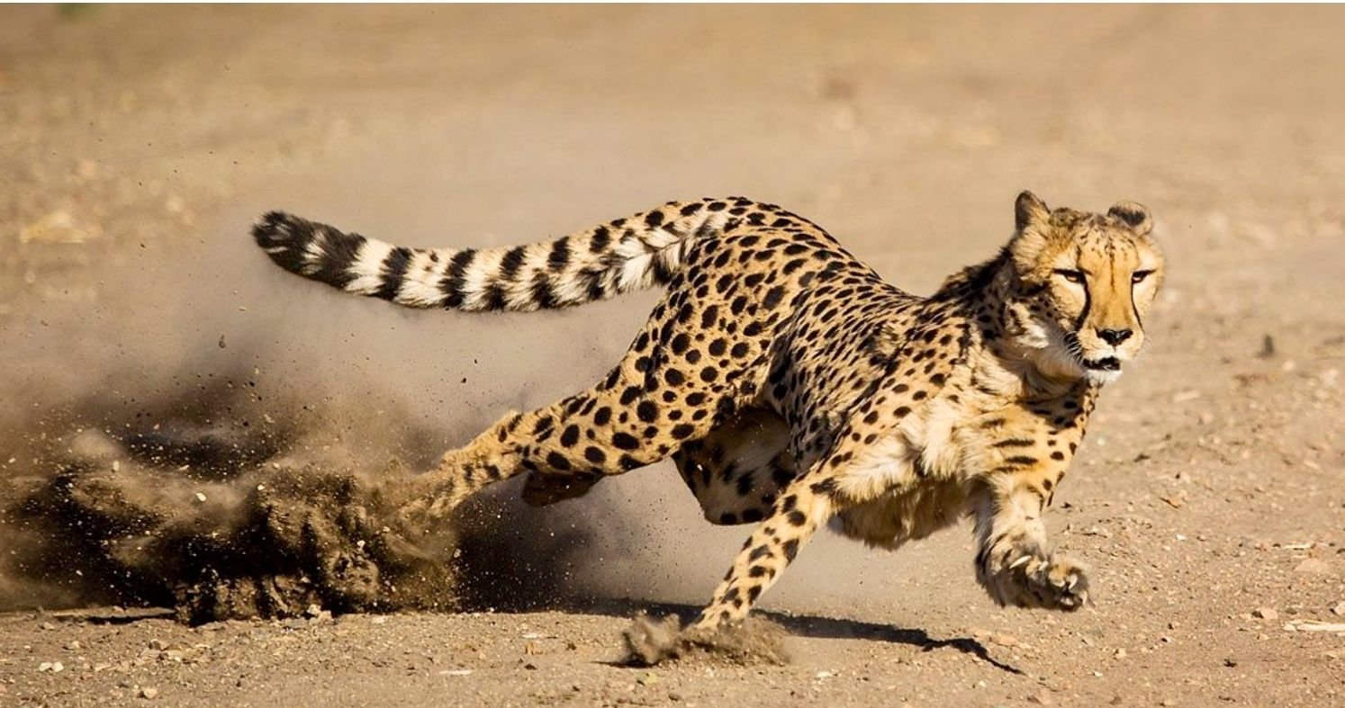
Research Approach
Cheetah
PINT
Accelerating Databases
Collecting Telemetry Information
Goal
Programming Abstraction
Pruning packets without affecting the output
Aggregating values observed by packets
Algorithm Design
Compressed history summarization on switch
Distributed encoding schemes
Prototype
Notes:
Think of challenges?
Change colors
Remove abstractions?

Slide 64
Challenges of Running Algorithms on PISA
Constrained memory access:
Partitioned between stages
Can only R/W one address per stage
Computation: only basic arithmetic
Limited memory size, limited #stages
…
64
Notes:
Mention that the word size is ~8B
Highlight in the previous slide
Recirculation can help a lot (simplified operation in each pass), but hurts throughput
Switch may have a small reserved capacity for recirc. No penalty.

Slide 65
Today’s Agenda
Cheetah: Accelerating Database Queries with Switch Pruning
Joint work with
Minlan Yu, Muhammad Tirmazi, and Jiaqi Gao (Harvard)
PINT: Probabilistic In-band Network Telemetry
Joint work with
Minlan Yu, Michael Mitzenmacher, Shivaram Ramanathan, Yuliang Li (Harvard) and Gianni Antichi (QMUL)
65

Slide 66
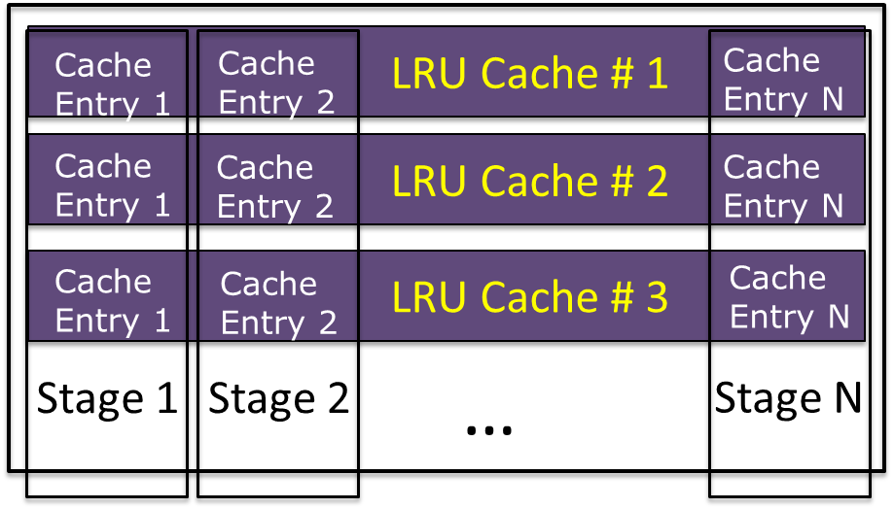
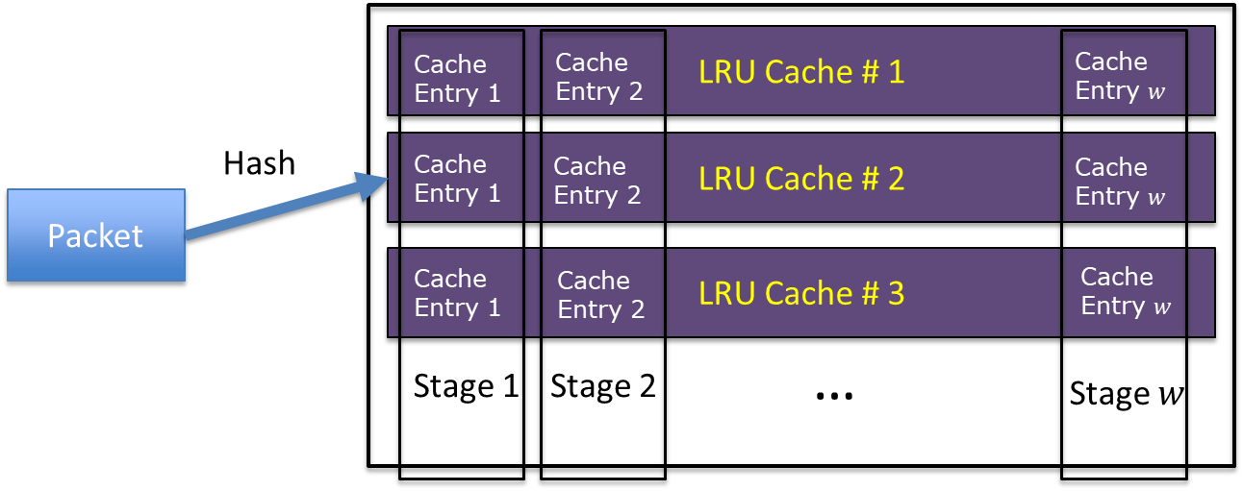
Example #1: Distinct Query
Selects all the distinct values
E.g., SELECT DISTINCT seller FROM Products
Strawman solution: Bloom Filters
Problem: have false positives which may drop distinct entries
But a cache works!
Our solution: Multi-row LRU cache
66
Notes:
Multi-row to reduce the number of per-packet comparison
Implement LRU with a rolling replacement across stages

Slide 67
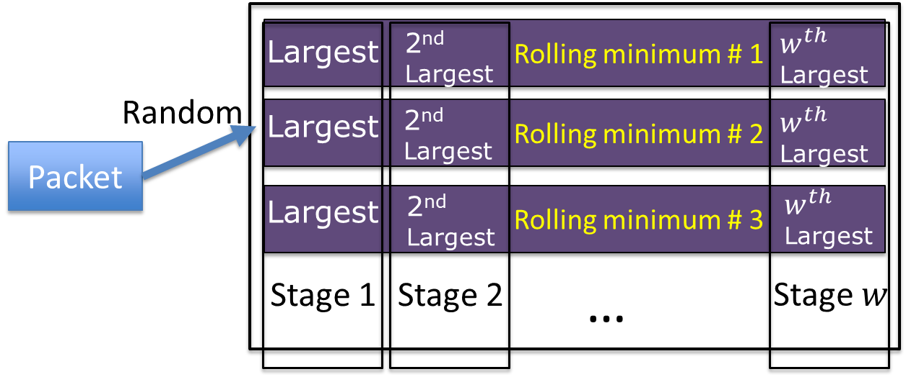
Example #2: Top N
Compute the largest N entries in the queried column
E.g., SELECT TOP 100 * FROM Products ORDER BY price
Strawman solution: Store the N largest so far
Problem: N is often too large compared with the number of stages.
Our solution: Randomly partition the space
67

Slide 68
The power of Coding
A
B
C
The Baseline would:
Get information on the first packet.
Require 1.5 packets on average to get the second hop ID.
Need 3 packets for sampling the last hop.
Overall: $1+1.5+3=5.5$ packets in expectation.
Consider sampling with probability 0.5, and writing $A⊕B⊕C$ otherwise
If the first packet is an ID (e.g., $A$),
$$C$$
𝐴⊕𝐵⊕𝐶
𝐴⊕𝐵⊕𝐶
$$B$$
68

Slide 69
INT
Payload
Payload

Slide 70
This is food for researchers!
70
Notes:
And this really allows us, as researchers, to do some really cool works and help many applications.

Slide 71
Programmable Data Planes: not an academic dream
71
Notes:
And major companies are buying programmable switches to replace traditional ones

